Slide 1
Strategic Risk Management & Operational Intelligence
Balancing Capital Preservation with Sustainable Growth
How we use data-driven decisioning to reduce financial loss, automate customer approvals, and optimize our physical assets.
Henry Dibie

Slide 2
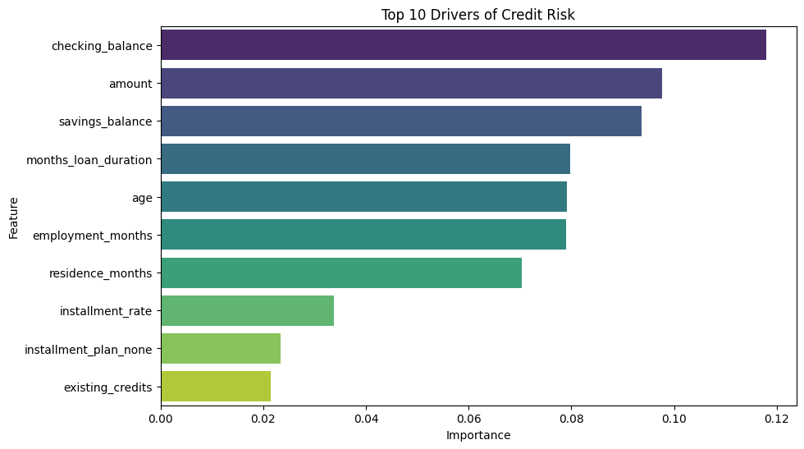
Identifying Our Risk Drivers
What Determines a High-Risk Borrower?
Cash Reserves (The Primary Filter): Our data shows that the "Checking Balance" is the strongest predictor of success. Borrowers without a cash buffer are significantly more likely to default during minor financial setbacks.
Loan Exposure: We identified that longer-term loans (4+ years) carry a disproportionate amount of risk. The longer the "window of exposure," the higher the probability of a life event (job loss, medical issue) affecting repayment.
Past Reliability: Credit history remains a cornerstone of our model. We prioritize applicants with a proven track record of managing multiple credits over time.

Slide 3
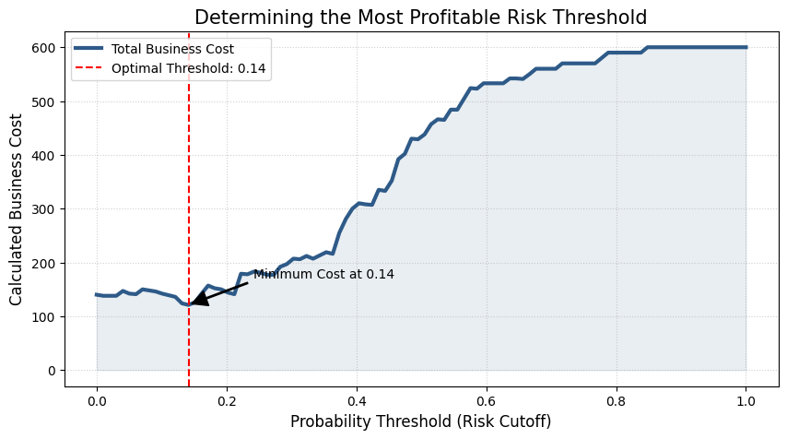
Strategic Balancing (The 10:1 Rule)
Prioritizing Capital Preservation Over Volume
The Business Reality: In our current economic climate, the financial loss of one default is equal to the profit we make from ten successful loans.
Our Decision Strategy: To protect the bank’s capital, we have tuned our screening tool to be "conservative.“
The Result: We will intentionally decline "borderline" applicants. While this may slightly reduce total loan volume, it significantly increases the overall profitability and safety of our loan book.

Slide 4
The Safety Net (External Data Integration)
Seeing the Full Picture with Bureau Data
Internal vs. External Risk: An applicant may look healthy based on the information they give us, but they may be over-leveraged with other lenders.
The "Reject Overlay": We have integrated external Credit Bureau data to catch "hidden" risks.
Automated Protection: If an applicant’s external record shows a failure rate higher than 30%, our system triggers an Automatic Hard Reject, regardless of their internal score. This prevents us from being the "last lender" to a struggling borrower.

Slide 5
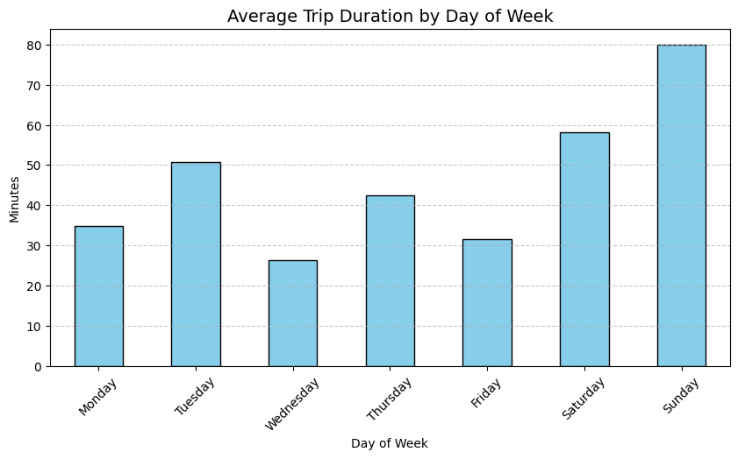
Operational Intelligence (Mobility Audit)
Maximizing Our Physical Asset Performance
Leisure vs. Utility: Our analysis of the bike-hailing data reveals that weekend trips are 3x longer than weekday commutes. We must shift our fleet to recreational hubs on Fridays to capture this high-revenue demand.
Predicting Equipment Failure: We’ve identified that 2-minute "short-swaps" are a signal of mechanical issues.
Proactive Maintenance: We are implementing a data-driven maintenance flag. This ensures our bikes are safe and available, reducing "lost revenue" from broken equipment during peak periods like September.

Slide 6
Deployment & Next Steps
Moving from Analysis to Action
Immediate Deployment: Integrate the new scoring tool into our digital application portal for instant decisioning.
Efficiency Gains: Automate 80% of approvals/declines, allowing our expert credit officers to focus their time only on complex, high-value cases.
Continuous Improvement: We will perform a quarterly "Health Check" on the model to ensure it adapts to changing market conditions and continues to protect our margins.

